Slide 1
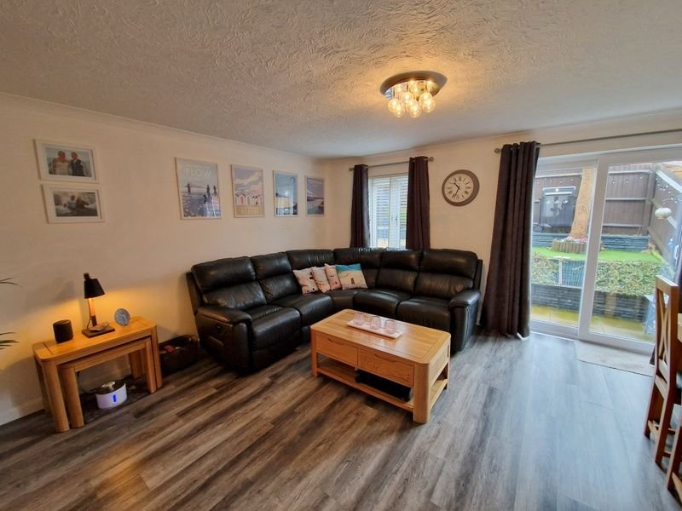
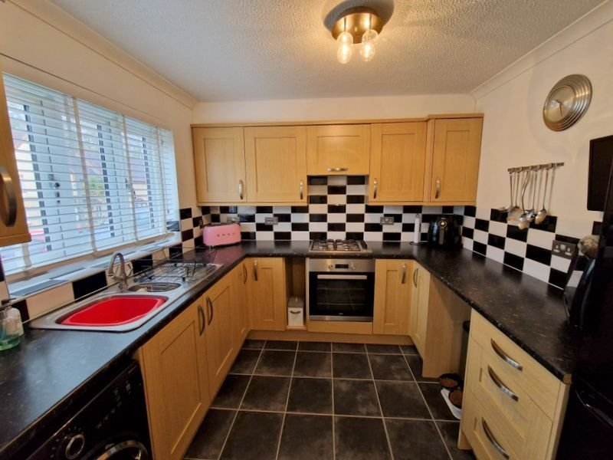
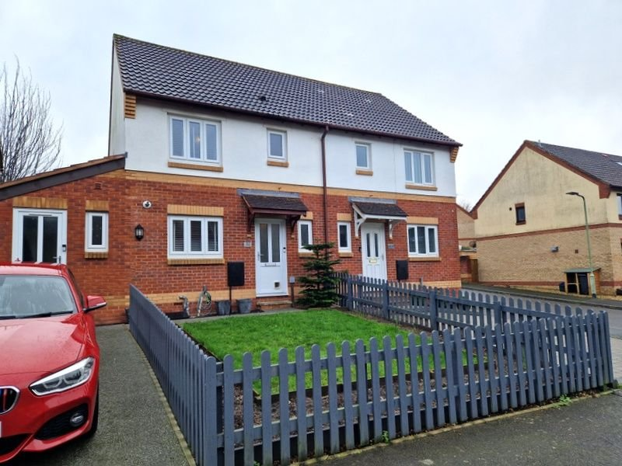
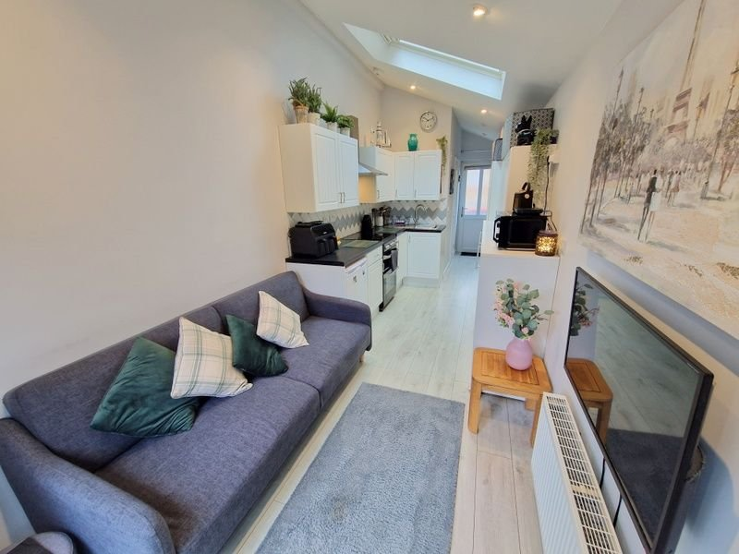
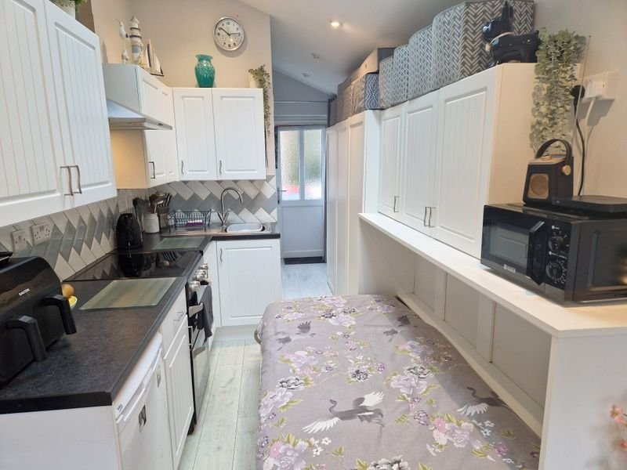
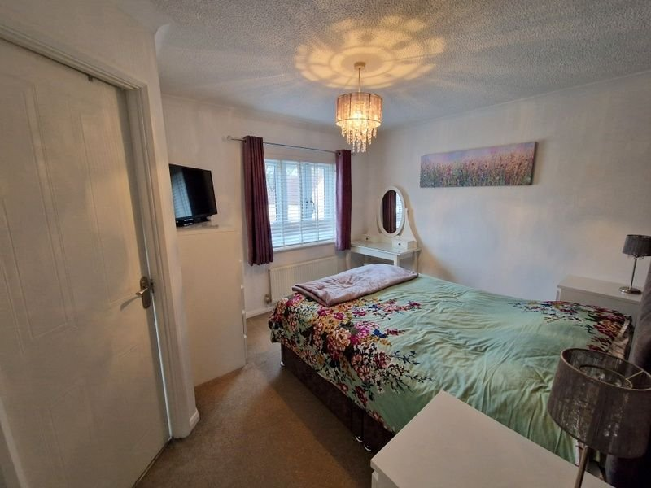
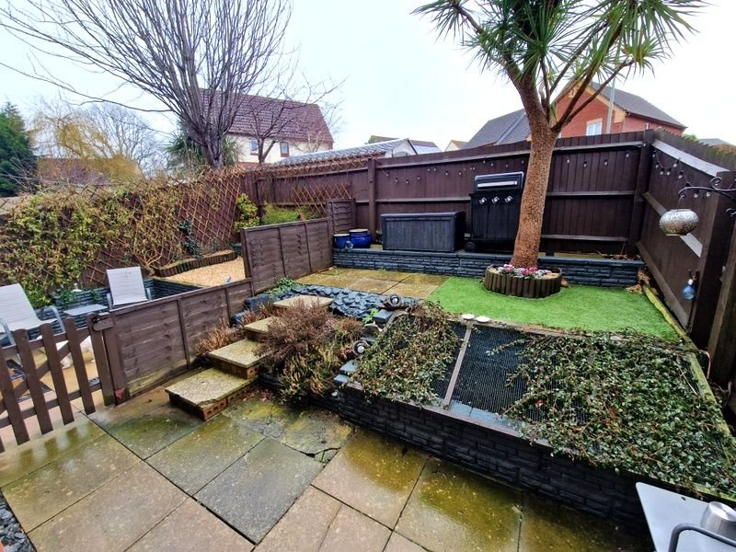
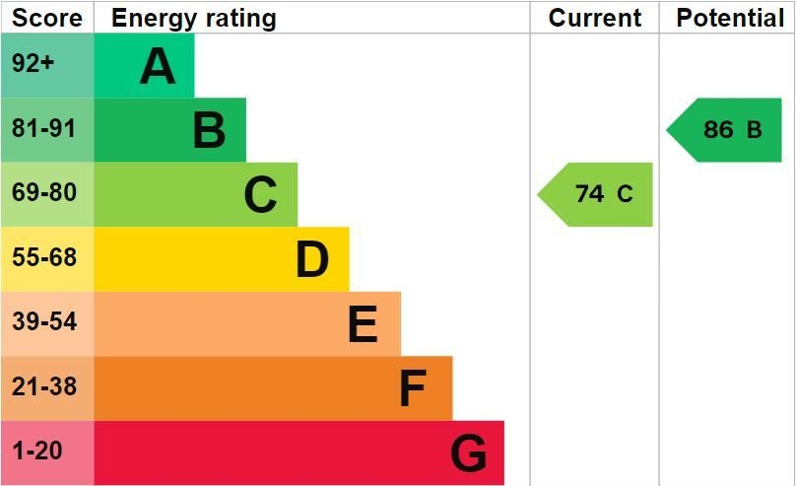
www.pennys.net
32 Wordsworth Close, Exmouth, EX8 5SQ
GUIDE PRICE £325,000
TENURE Freehold
A Beautifully Presented Semi Detached House With An Adjoining Self Contained Annexe With Separate Entrance
Lounge/Dining Room • Modern Kitchen •
Ground Floor Cloakroom/WC • Three Bedrooms - Main Bedroom With En-Suite Shower Room/WC • Family Bathroom/WC •
Open Plan Adjoining Annexe • Enclosed Rear Garden •
Off-Road Parking • Viewing Highly Recommended •
Pennys Estate Agents Limited for themselves and for the vendor of this property whose agents they are give notice that:- (1) These particulars do not constitute any part of an offer or a contract. (2) All statements contained in these particulars are made without responsibility on the part of Pennys Estate Agents Limited. (3) None of the statements contained in these particulars are to be relied upon as a statement or representation of fact. (4) Any intending purchaser must satisfy himself/herself by inspection or otherwise as to the correctness of each of the statements contained in these particulars. (5) The vendor does not make or give and neither do Pennys Estate Agents Limited nor any person in their employment has any authority to make or give any representation or warranty whatever in relation to this property.
PENNYS ESTATE AGENTS
2 Rolle House, Rolle Street, Exmouth, Devon, EX8 2SN
Tel: 01395 264111 EMail: help@pennys.net

Slide 2
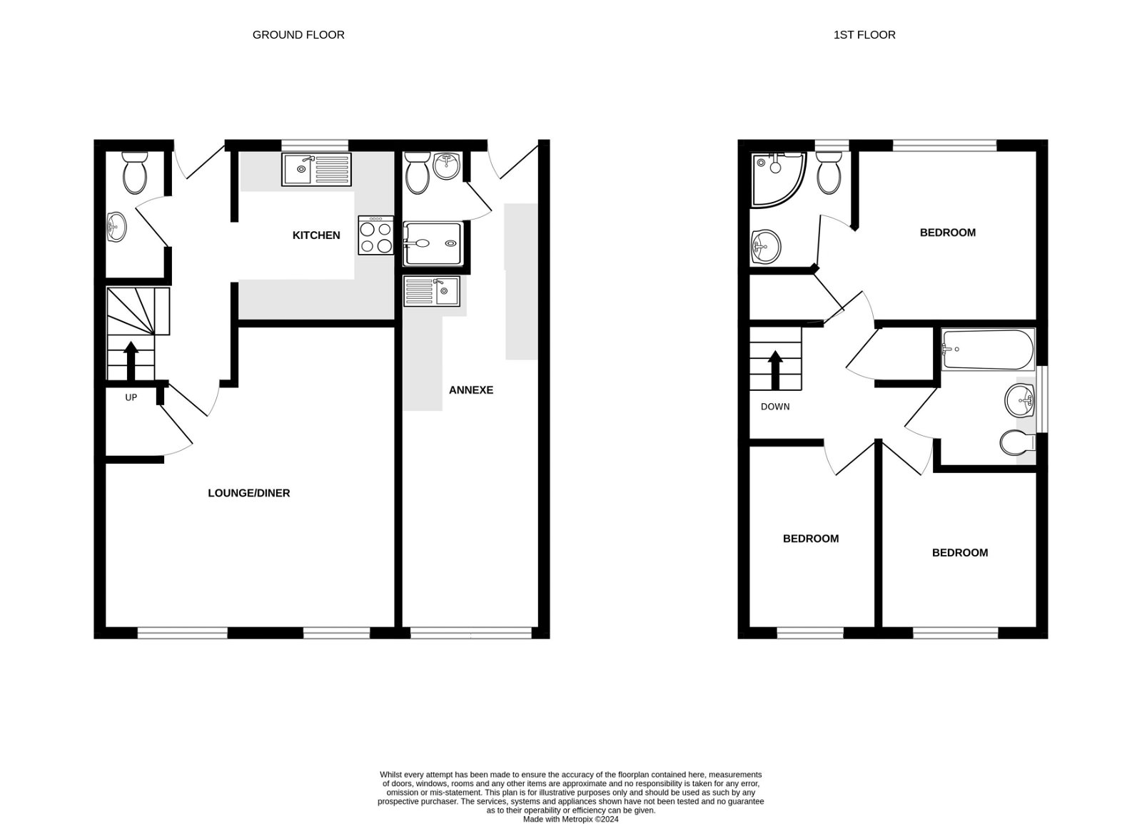
32 Wordsworth Close, Exmouth, EX8 5SQ
ENTRANCE CANOPY: With uPVC double glazed front door beneath to: RECEPTION HALL: Stairs to first floor landing; radiator; wood effect flooring. CLOAKROOM/WC: With vanity wash hand basin with splash back; WC with push button flush; radiator; wood effect flooring; electric consumer unit; uPVC double glazed window with pattern glass. KITCHEN: 2.67m x 2.59m (8'9" x 8'6") A modern kitchen with pattern worktop surfaces with cupboards, drawer units, plumbing for an automatic washing machine and further appliance space beneath; inset one and a half bowl single drainer sink unit with tiled surrounds; inset four ring gas hob with built-in oven beneath and extractor fan over; wall mounted cupboards (one housing modern gas boiler); space for upright fridge freezer; television point; uPVC double glazed window to front aspect. LOUNGE: 4.75m x 4.62m (15'7" x 15'2") A bright and spacious room with uPVC double glazed window and sliding double glazed patio doors to rear garden; wood effect flooring; television point; radiator; understairs cupboard. FIRST FLOOR LANDING: Access to loft space; radiator; airing cupboard housing water cylinder; doors to: BEDROOM ONE: 3.66m x 3.1m (12'0" x 10'2") uPVC double glazed window to front aspect; radiator; built-in wardrobe; television point. EN-SUITE SHOWER ROOM/WC: 1.73m x 1.73m (5'8" x 5'8") Shower cubicle; vanity wash hand basin; WC with push button flush; light shaver socket; extractor fan; uPVC double glazed window with pattern glass; chrome heated towel rail. BEDROOM TWO: 2.84m x 2.44m (9'4" x 8'0") uPVC double glazed window to rear aspect; radiator. BEDROOM THREE: 2.44m x 1.88m (8'0" x 6'2") uPVC double glazed window to rear aspect; radiator. BATHROOM/WC: 1.96m x 1.91m (6'5" x 6'3") With bath and shower attachment; pedestal wash hand basin; WC with push button flush; chrome heated towel rail; radiator; attractive part tiled walls; uPVC double glazed window with pattern glass. SELF CONTAINED ANNEXE: uPVC double glazed door to: ENTRANCE LOBBY: Ceiling spotlighting; opening through to: KITCHEN/LIVING/BEDROOM: 5.31m x 2.18m (17'5" x 7'2") A clear use of space providing an excellent living space for family members/office with vaulted style ceiling with recess spotlighting and velux window; laminate flooring; television point; radiator; double glazed doors to rear garden. Kitchen area is fitted with worktop surfaces with cupboards and drawer units beneath; inset single drainer sink unit; electric cooker point with chimney style extractor hood over; tiled surrounds; matching unit with 'pull out bed' with wall mounted kitchen cupboards over. OUTSIDE: The front garden is laid to lawn with stone resin driveway and path to front door; outside tap and outside light. The rear garden comprises of a patio terrace areas ideal for outside entertaining, raised decorative stone garden, further patio area and artificial lawn; outside tap and lighting; palm tree, raised flower beds and fish pond.
FLOOR PLAN:

